Slide 1
Phonetic Science for Clinical Use
A Guide to Online Student & Instructor Resources
Dr. Kathy J. Jakielski & Dr. Christina Gildersleeve-Neumann

Slide 2







Student Resources
Audio sound files
Flashcards for vocabulary
Mnemonic flashcards for IPA symbols
Printable study aids
Phonetic transcription readiness quiz
Phonetic transcription readiness tutorials
Audio case studies of typical speech development
Video case studies of disordered child speech

Slide 3
Student Resources
Audio sound files: Ability to click on highlighted a symbol or word to hear its pronunciation
Flashcards for vocabulary: Terms taken from each chapter presented in PowerPoint slides
Mnemonic flashcards for IPA symbols: Clever visual aids to remember unusual symbols
Printable study aids: Student note-taking slides from the instructor PowerPoint presentations for each chapter
Phonetic transcription readiness quiz: Student-managed quiz
Phonetic transcription tutorials: Study lessons to improve readiness skills
Audio case studies of typical speech development: Brief speech samples, IPA transcriptions, & analyses
Video case studies of disordered child speech: Brief speech samples, IPA transcriptions, & analyses

Slide 4
Phonetic Transcription Readiness Quiz
Discussed on page 16 in the second edition
Multiple choice quiz tests 5 core skills at easy, intermediate, & difficult levels:
1. Counting sounds in words.
How many consonant & vowel sounds are in the word “rainbow?” (5)
2. Specifying phonotactic structure of words.
What is the consonant & vowel pattern in the word “rainbow?” (CVCCV)
3. Specifying number of syllables in words.
How many syllables are in the word “rainbow?” (2)
4. Identifying primary stress in words.
Which syllable carries the prominent stress in the word “rainbow?” (first)
5. Specifying stress patterns in words.
What is the stress pattern in the word “rainbow?” (Sw)

Slide 5
Phonetic Transcription Tutorials
Students take the quiz & each of the 5 skill areas is graded
Weak skill areas are identified for students
Students can then complete the tutorials for any of the five skills they want to improve
Examples in the tutorials move from easy to intermediate to difficult levels:
1. In each skill area, written words are shown, as well as spoken.
2. Students are asked to practice the skill, with examples becoming increasingly more difficult.
3. Each answer is explained.

Slide 6
Video
Case Studies of Children with SSD
Introduced on page 220
(Audio case studies of developmental errors introduced on page 118)
12 different speech samples from 1-5 minutes long
All children exhibit a speech sound disorder & are enrolled in therapy
Orthographic transcription of target words is provided for students to phonetically transcribe the child’s actual pronunciation
Clinical questions are provided to encourage students to analyze the child’s speech errors
Our phonetic transcription of target words is provided & our analyses are also provided
We include a table of common child consonant error patterns using the SODA format (Table 7-7) & common vowel phonological processes (Table 8-7)

Slide 7
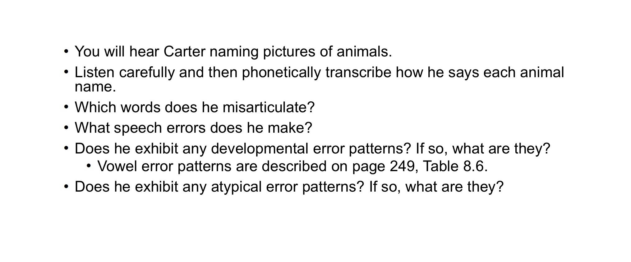
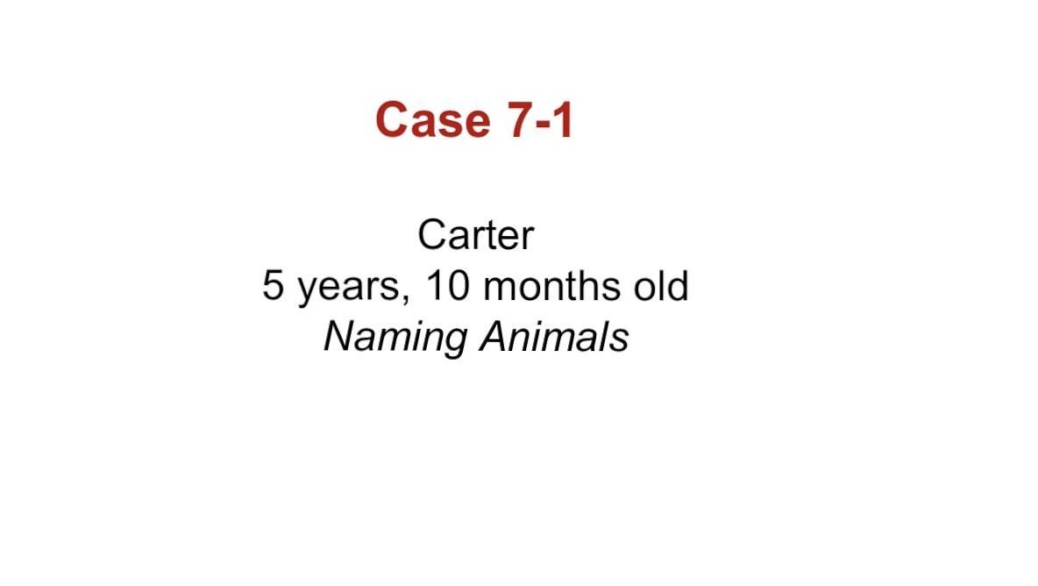

Slide 8
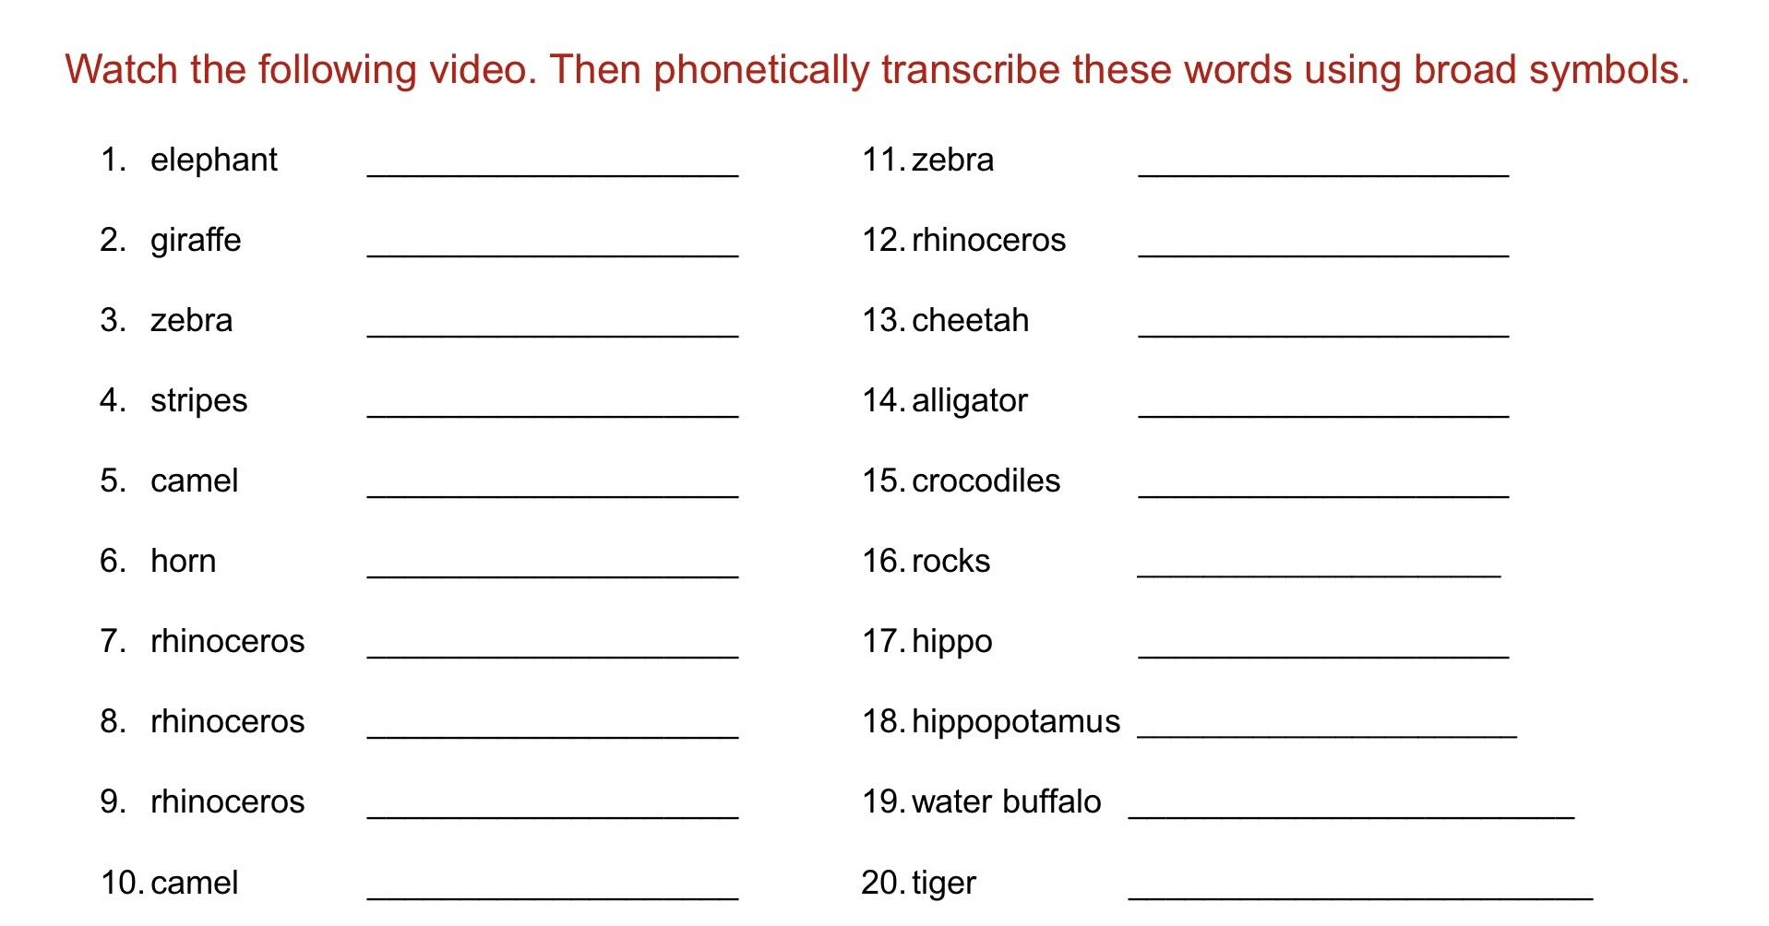


Slide 9
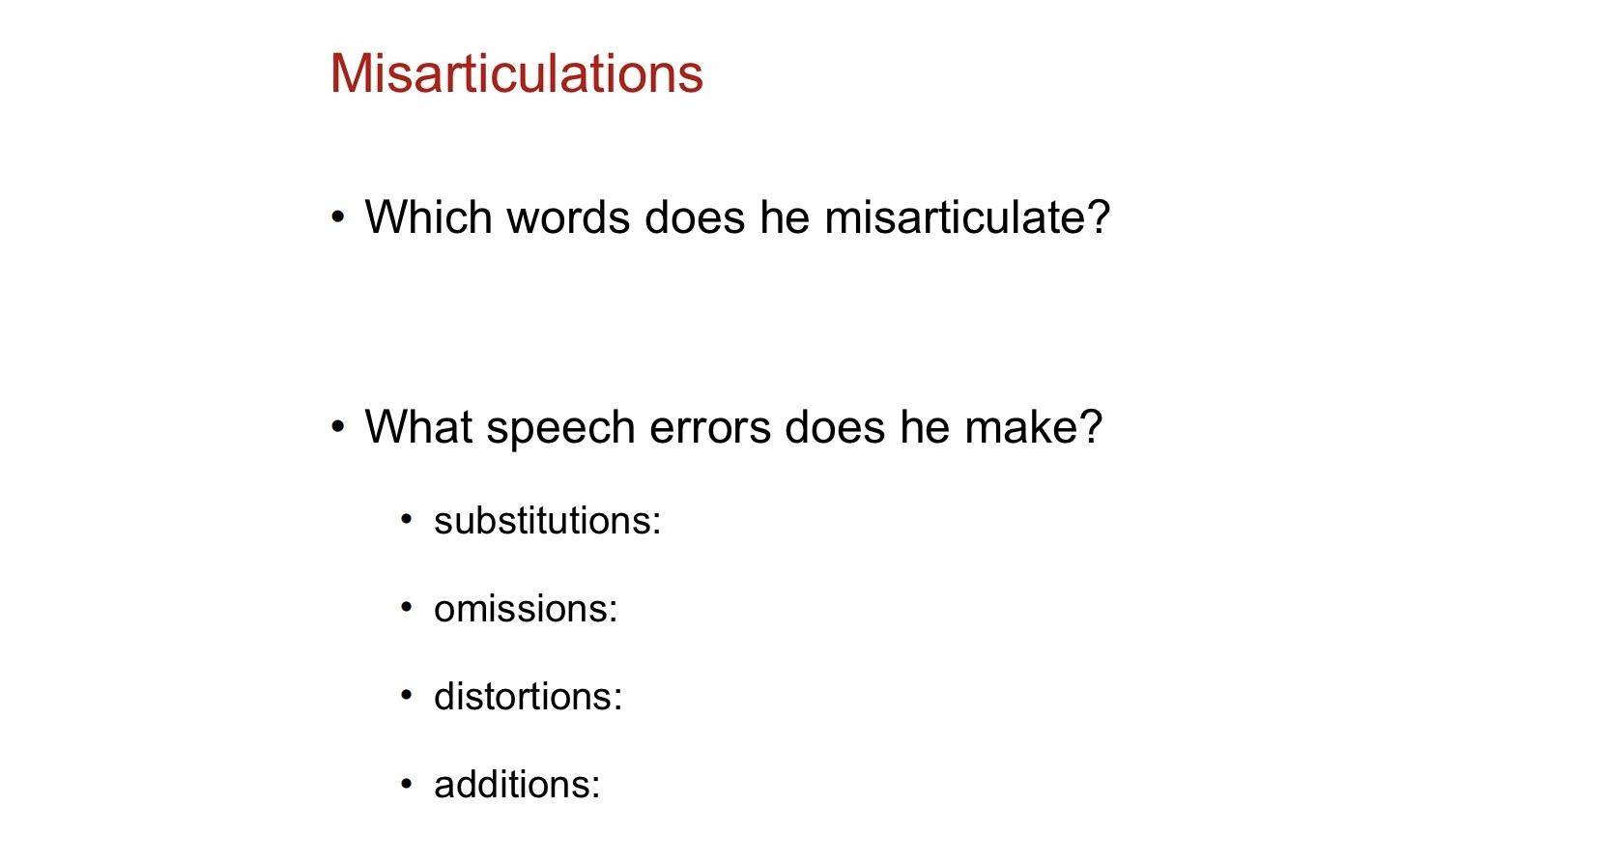

Slide 10
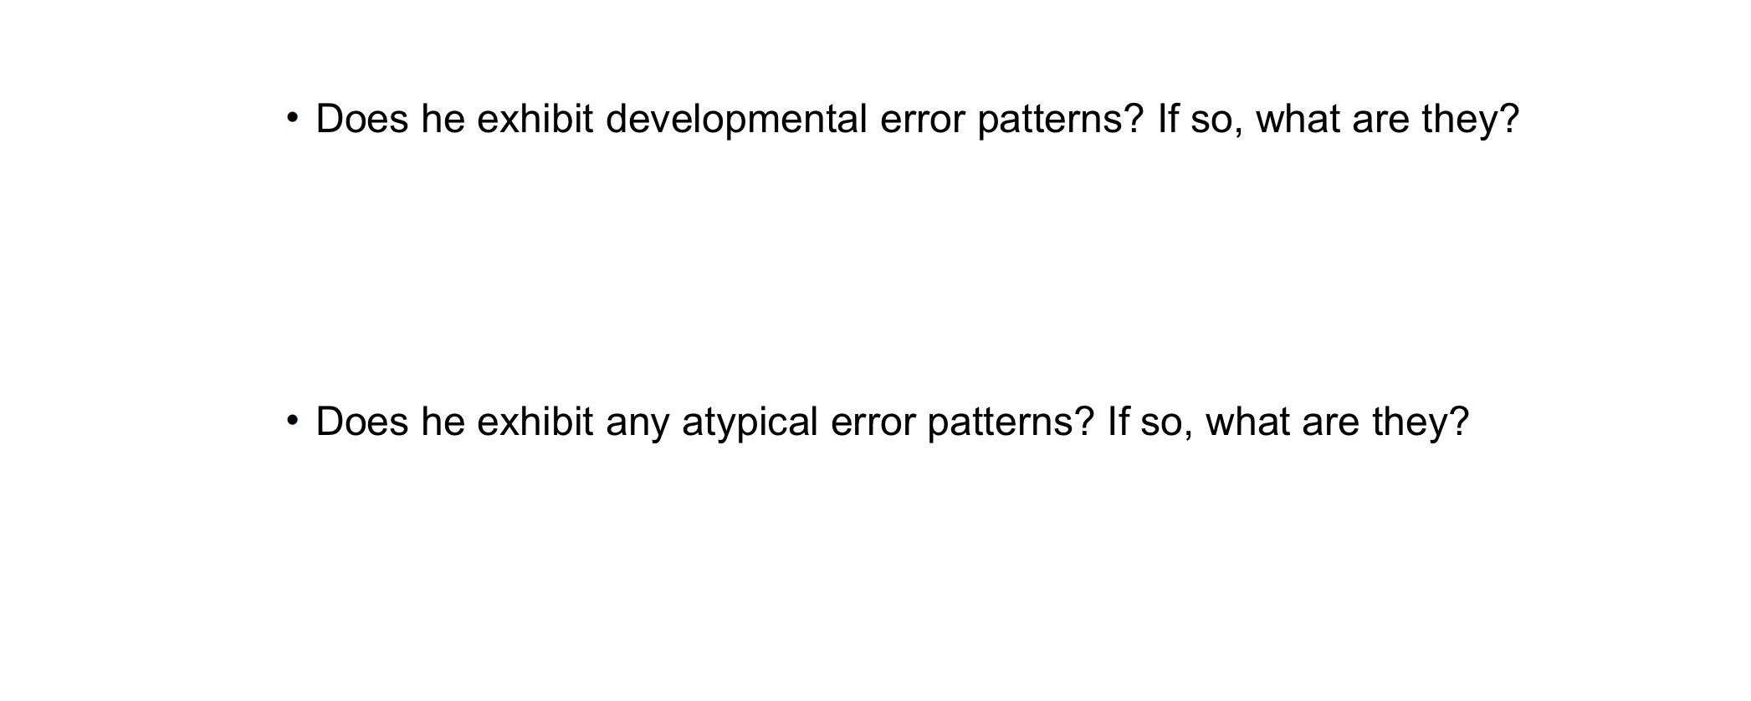

Slide 11
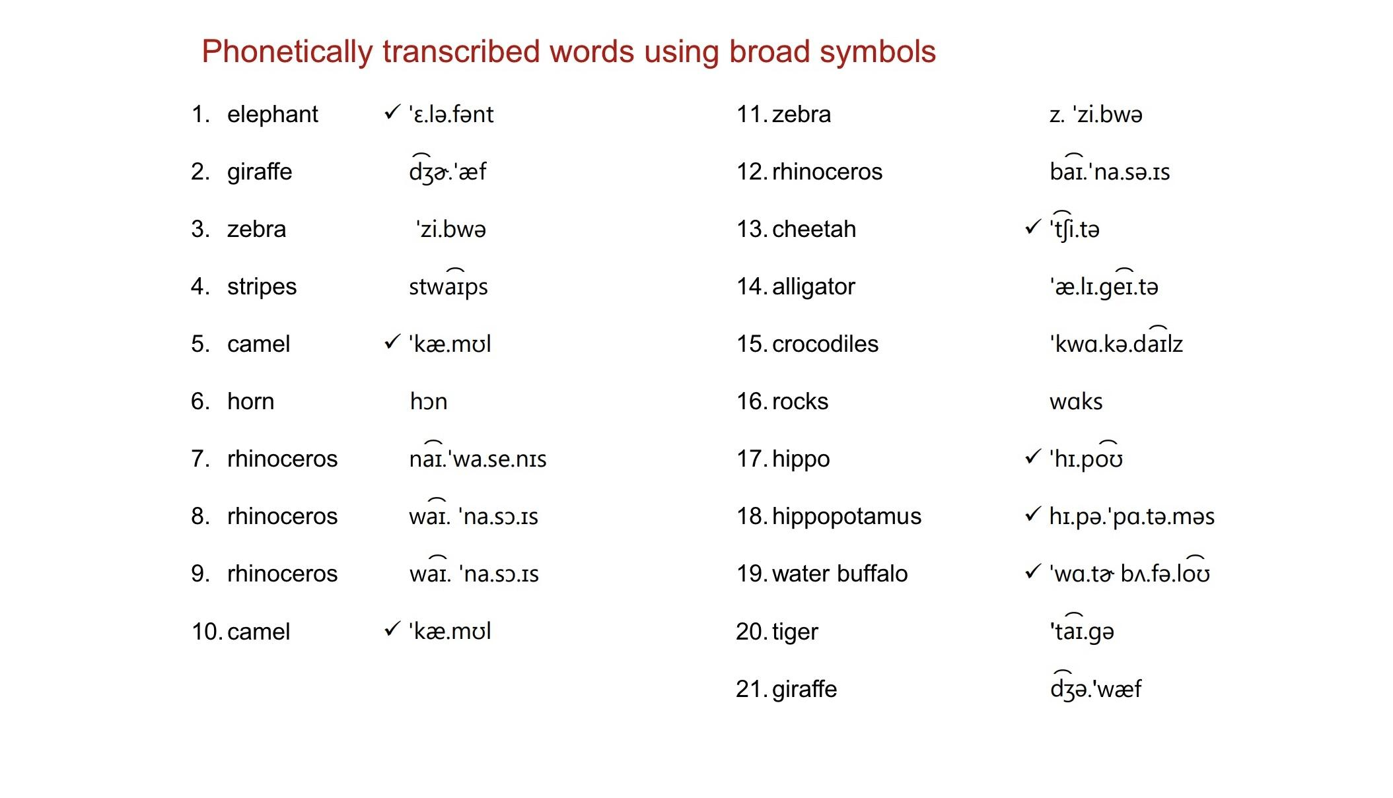

Slide 12
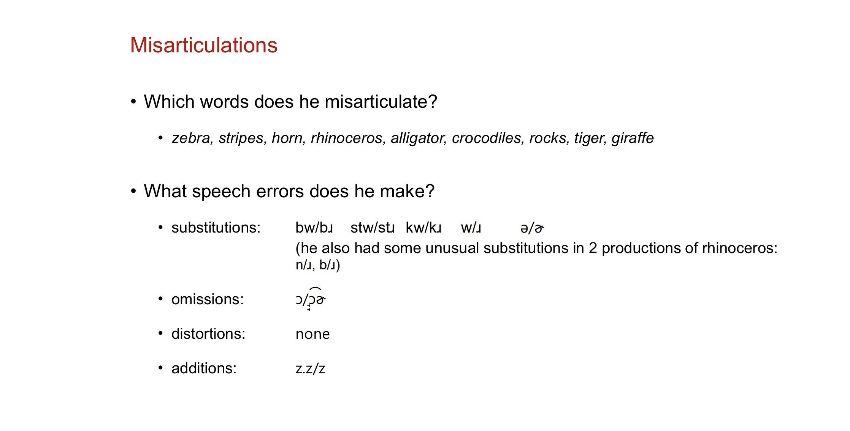

Slide 13
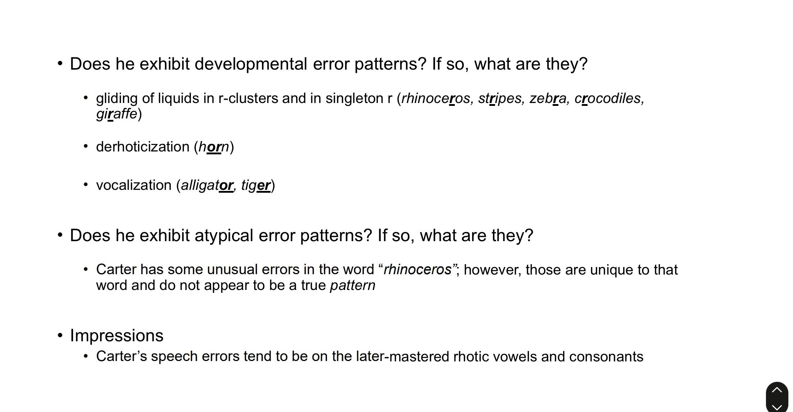

Slide 14
Audio
Case Studies of Children with and without SSD
12 different English speech samples. Each child’s sample is a subset of the Phonological and Bilingual Assessment (PABA) administration.
English-only and English-Spanish bilingual children between the ages of 3;4 and 5;2. A brief background for each child is included..
All children make speech sound errors. Some children are typically-developing and some children have SSDs.
Orthographic transcription of target words is provided. Students transcribe target productions and the child’s recorded productions.
Clinical questions are provided to encourage students to analyze the child’s speech errors
Our phonetic transcription of target words & our analyses are also provided. An overall summary of the child’s speech and typical or atypical speech development signs is also provided

Slide 15
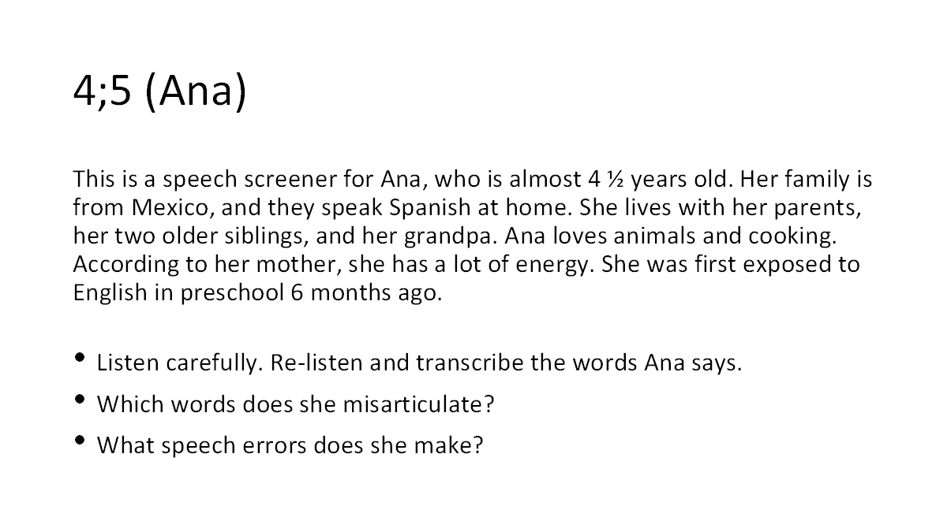

Slide 16
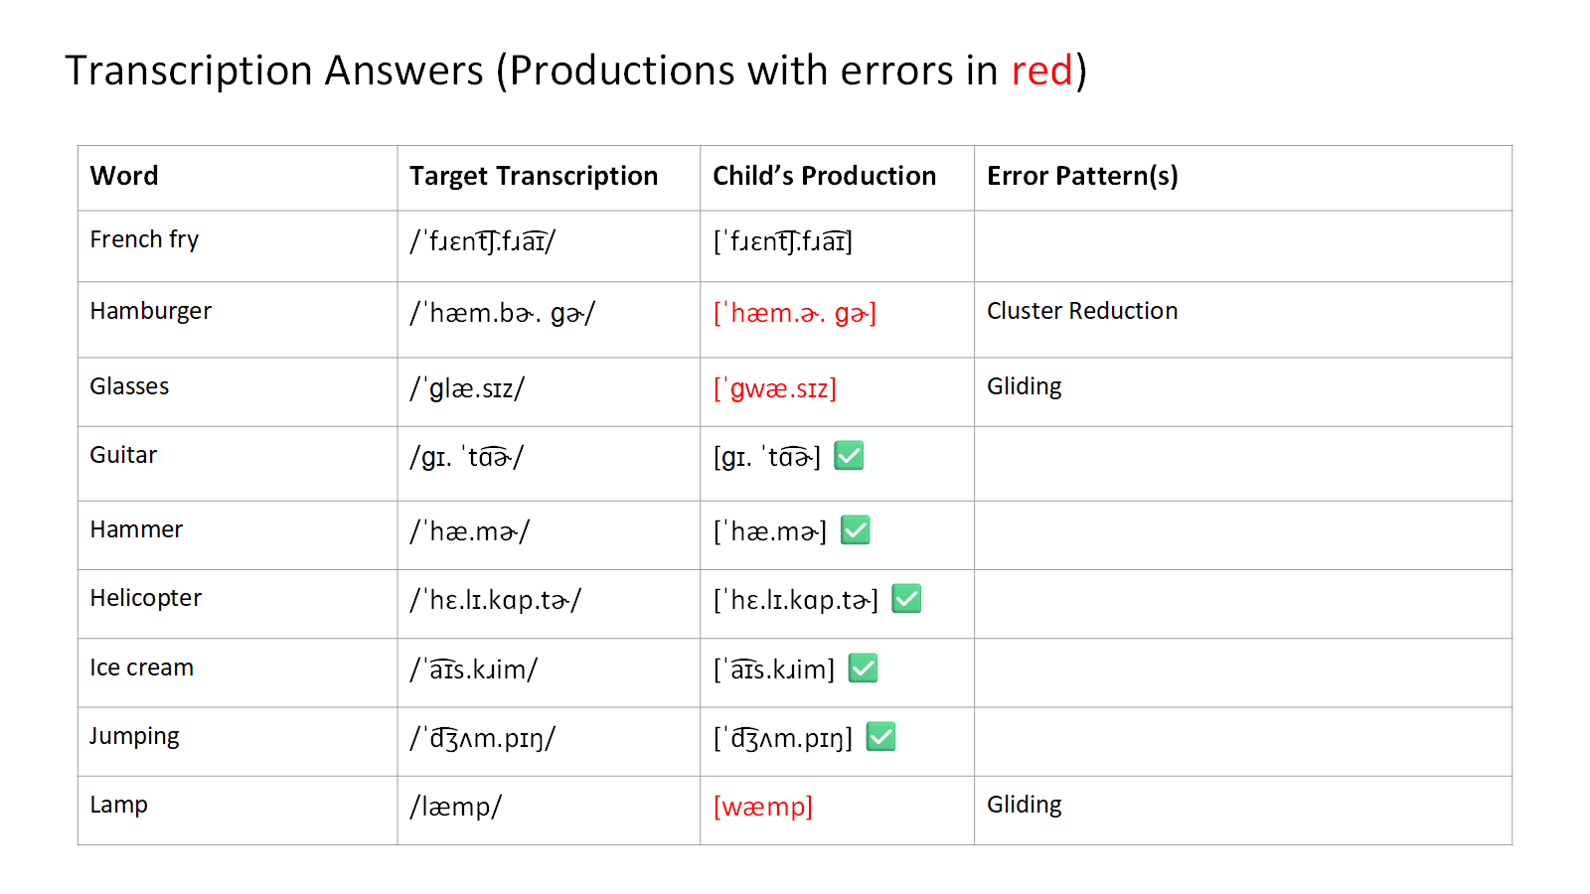

Slide 17
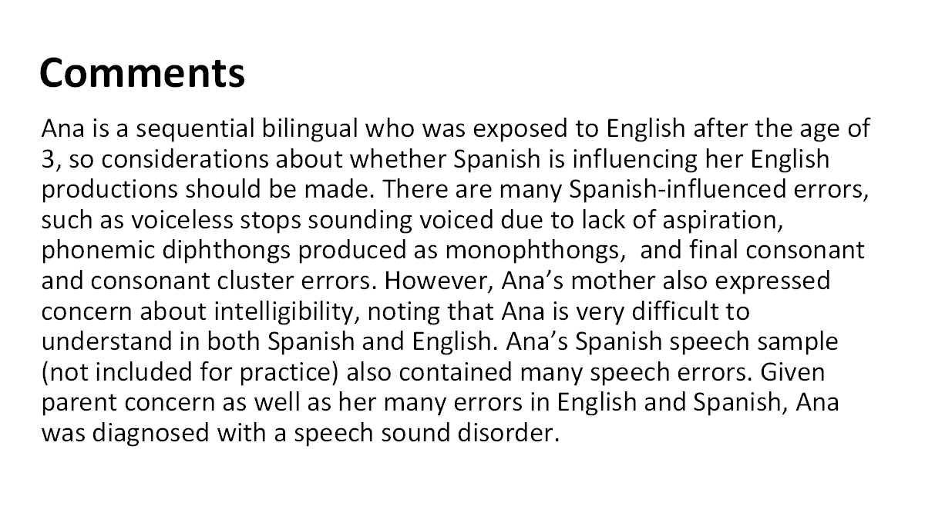

Slide 18
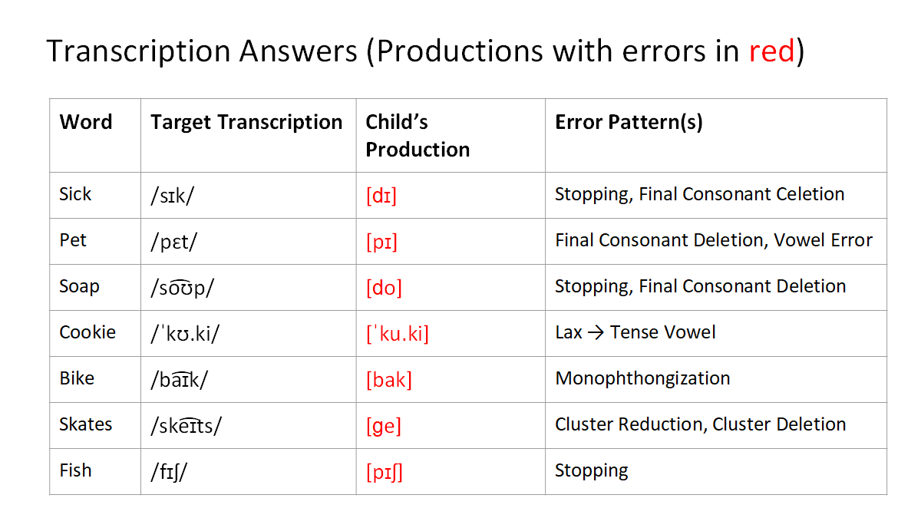

Slide 19
Faculty Resources
Instructor teaching slides.
Instructor summaries.
Syllabi templates.
Did You Get Its (DYGIs)
Applied Science chapter frameworks
Self-assessment tool for students: Answer key
Assessment of phonetic knowledge and skills
Instructor exam review slides
Exam Questions for each book chapter

Slide 20
Faculty Resources
Instructor teaching slides. 38-84 slides per chapter. Include figures & tables. Acoustics’ chapter divided into four subsets.
Instructor summaries. Outline of chapter topics for review.
4 syllabi templates (11 & 15 week courses; 2 or 3 meetings/wk
DYGIs. Review questions & scenarios to ensure topic understanding
Applied Science chapter frameworks.
Self-assessment tool for students: Answer key
Assessment of phonetic knowledge and skills. Determine preparedness for undergrad & grad SSD courses.
Instructor exam review slides.
25 Multiple Choice Exam Questions for each book chapter

Slide 21
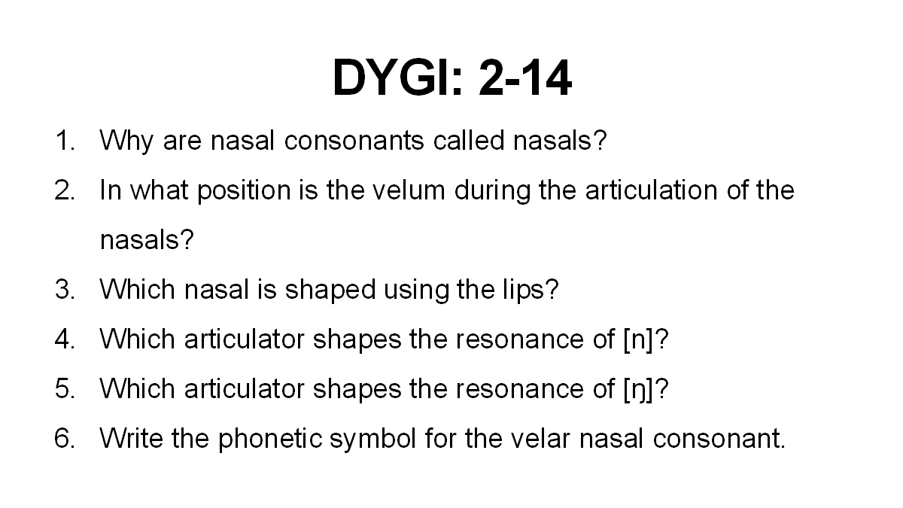

Slide 22
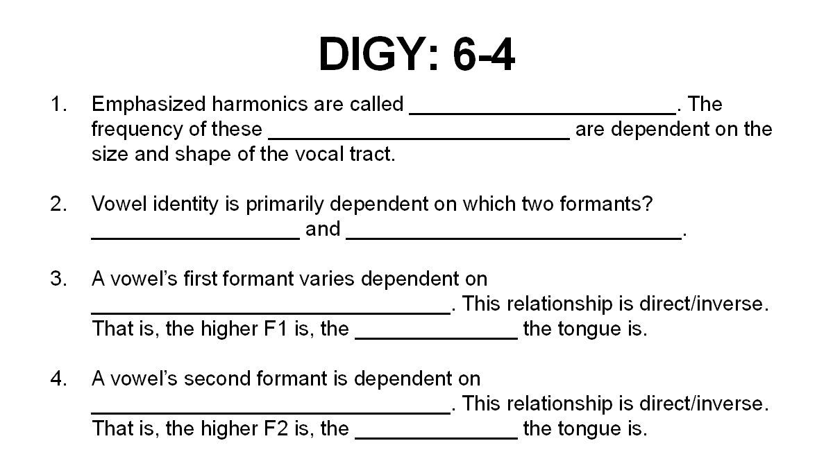

Slide 23
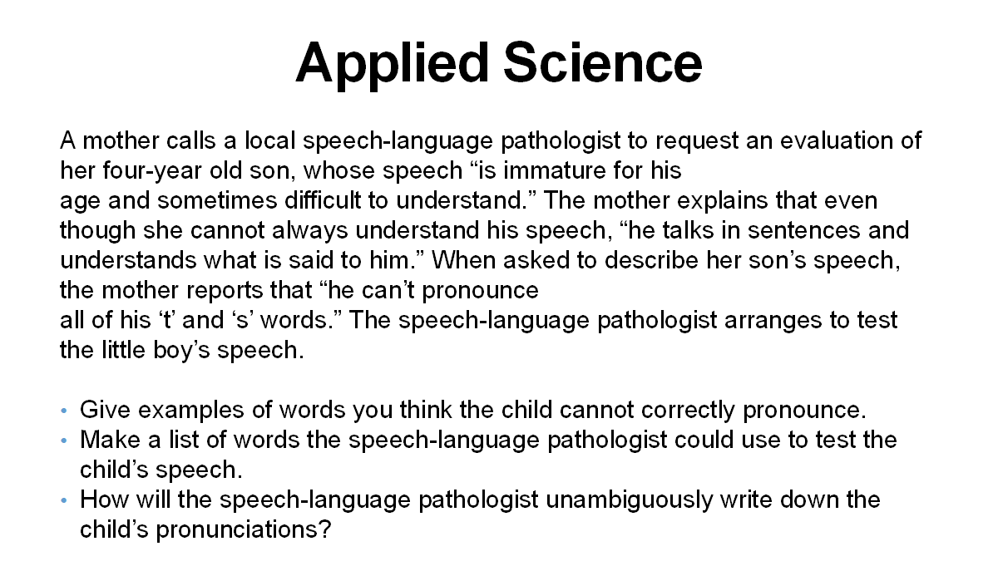

Slide 24
Assessment of Phonological Knowledge & Skills
Differences in phonetics’ knowledge of SSD students. Varied preparedness for transcribing and analyzing speech.
Refresh skills with student self-assessment quiz
Assessment
  Tests five core phonetic topics
  Add phonetic transcription by hand.
Provide students with results and textbook sections to review.
Supplement with workbook.

Slide 25
I. Sounds in Words
2. How many speech sounds are in the word moisturizing?
a. 3
b. 4
c. 5
d. 6
e. 7
f. 8
g. 9
h. 10
i. 11
j. 12

Slide 26
I. Phonotactic Structure
7. What is the phonotactic structure of the word energy?
a. VCV.CCV
b. V.CVC.CV
c. VC.V.CV
d. V.CV.CV

Slide 27
III. Lexical Stress Patterns
9. Name the stress pattern in the word configuration.
a. wSwww
b. wwSww
c. Swwww
d. wwwSw

Slide 28
IV. Consonant Voicing, Place, and Manner. Match the IPA symbol with its description.
V. Phonology of Consonants and Vowels
1. In which word is an unreleased stop most likely to be produced?
a. pan
b. pouch
c. napped
d. nice

